Slide 1
Experimental validation of the free-energy principle with in vitro neural networks
Isomura, Kotani, Jimbo & Friston
Nature Communications 2023

Slide 2
Free Energy Principle
Karl Friston
Statistical parametric maps in functional imaging: a general linear approach (1994)
Dynamic Causal Modeling (2003)
The free-energy principle: a unified brain theory? (2010)
Notes:
Neuroimaging pioneer. Psychiatrist neuroscientist physicist. 347k citations

Slide 3
Free Energy Principle
(Biological) systems aim to resist entropy.
Brains strive to minimize a quantity called "free energy,"
Free energy can be thought of as a measure of surprise or uncertainty about the environment.
Notes:
It is a principle of least action

Slide 4
Free Energy Principle
Free Energy = Expected Energy - Entropy
It is the measure of surprise about the joint occurrence of sensations and their perceived causes.
Notes:
It is a principle of least action

Slide 5
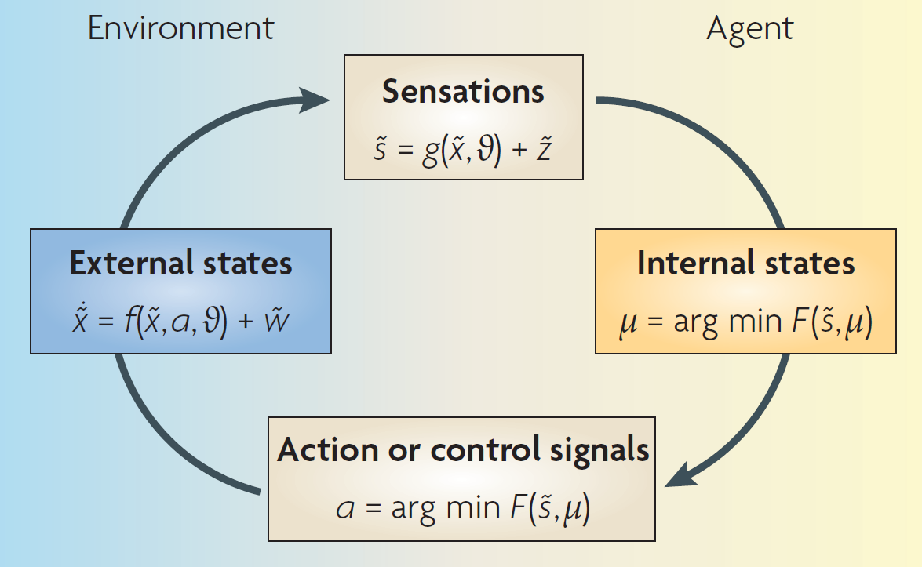
Friston (2010)

Slide 6
Friston (2010)
Notes:
The figure details a neuronal architecture that optimizes the conditional expectations of
causes in hierarchical models of sensory input. It shows the putative cells of origin of forward
driving connections that convey prediction error (grey arrows) from a lower area (for
example, the lateral geniculate nucleus) to a higher area (for example, V1), and nonlinear
backward connections (black arrows) that construct predictions41. These predictions try to
explain away prediction error in lower levels.

Slide 7
Free Energy Principle
“Surprise” = Free energy
“Belief” = Free energy minima
Carhart-Harris et al. (2023)
Notes:
Agents can
suppress free energy by changing the two things it depends
on: they can change sensory input by acting on the world
or they can change their recognition density by changing
their internal states.

Slide 8
FEP: a unified brain theory? (2010)
Action involves the agent selectively perceiving what it expects.
This is “active inference”
Imagine feeling around in the dark: you anticipate what you might touch next, then try to confirm your expectation
Notes:
This formulation shows that minimizing
free energy by changing sensory data (without changing
the recognition density) must increase the accuracy of
an agent’s predictions. In short, the agent will selectively
sample the sensory inputs that it expects. This is known
as active inference16. An intuitive example of this process
(when it is raised into consciousness) would be feeling
our way in darkness: we anticipate what we might touch
next and then try to confirm those expectations.

Slide 9
FEP: a unified brain theory? (2010)
Recognition is a probabilistic representation of what caused a particular sensation.
Predictions about the environment can be encoded as neuronal activity & connection strengths
Recognition can be considered in terms of a Bayesian prior.

Slide 10
FEP: a unified brain theory? (2010)
Free energy principle fits with:
Bayesian brain
Predictive coding
Information Theory
Stochastic Gradient Descent
You name it.
Notes:
(Any method for minimizing uncertainty)

Slide 11
Isomura et al. (2023)
Attempts to validate the FEP in vitro:
Cultured “neuronal network” learns source separation.
Will it act like a variational Bayes model?
Notes:
Variational bayes is a family of techniques for approximating posterior probability of unobserved variables

Slide 12
Isomura et al. (2023)
Rat neurons are cultured on micro electrode array (MEA).
Two hidden sources stimulate neurons via mixed outputs.
Can the FEP predict the self-organization of neuronal networks?
Notes:
Will the neurons recognize the hidden sources?

Slide 13
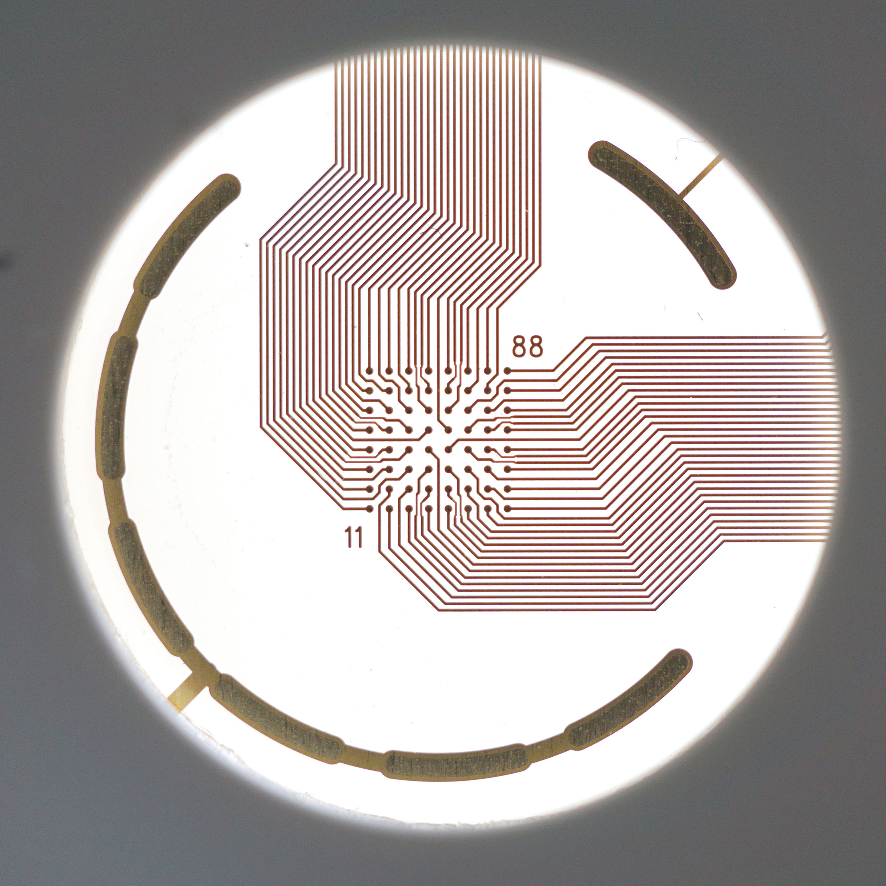
Experiment
100 sessions / 10 days
21 cell cultures
Notes:
Will the neurons recognize the hidden sources?
In this work, 21 independent cell cultures were used for the control
condition to conduct 30 independent experiments, 6 were treated
with bicuculline, 7with diazepam, 9with APV, 4were trained under the
0% mix condition, and 4 under the 50% mix condition.

Slide 14
Experiment
256s session
Random stimulation (32 sites) every second
244s rest period
Notes:
Will the neurons recognize the hidden sources?
In this work, 21 independent cell cultures were used for the control
condition to conduct 30 independent experiments, 6 were treated
with bicuculline, 7with diazepam, 9with APV, 4were trained under the
0% mix condition, and 4 under the 50% mix condition.

Slide 15
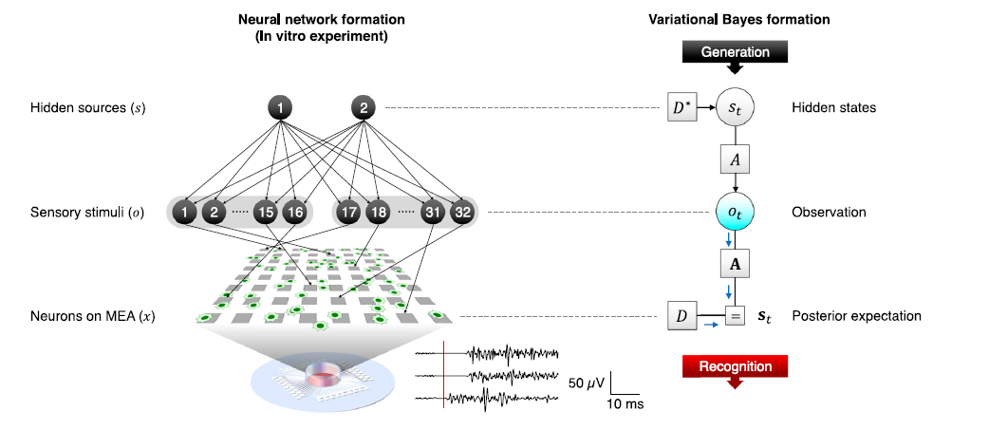
Notes:
Each element of s and o
took either a 1 (ON) or a 0 (OFF) state. The left stimuli group
(o1, . . . ,o16) in Fig. 1a (left) took the value of source 1 with a 75% probability
or the value of source 2 with a 25% probability. In contrast, the
right group (o17, . . . ,o32) took the value of source 1 or 2 with a 25% or
75% probability, respectively. Analogous to the cocktail party
effect27,28, this setup is formally homologous to the task of distinguishing
the voices of speakers 1 (s1) and 2 (s2)
The cerebral cortex was
removed from 19-day-old embryos (E19) and dissociated into single
cells by treatment with 2.5% trypsin (Life Technologies, Carlsbad, CA,
USA) at 37 °C for 20min, followed by mechanical pipetting. Half a
million dissociated cortical cells (a mixture of neurons and glial cells)
were seeded on the centre of MEA dishes, where the surface of MEA
was previously coated with polyethyleneimine (Sigma‒Aldrich, St.
Louis, MO, USA) overnight. These cells were cultured in the CO2
incubator. Culture medium comprised Neurobasal Medium (Life
Technologies) containing 2% B27 Supplement (Life Technologies),
2mM GlutaMAX (Life Technologies), and 5–40 U/mL penicillin/streptomycin
(Life Technologies). Half of the culture medium was changed
once every second or third day. These cultures were recorded during
the age of 18–83 days in vitro. During this stage, the spontaneous firing
patterns of the neurons had reached a developmentally stable
period

Slide 16
Experiment
Reverse engineer generative model from neuronal responses.
Compare empirically-derived against with Bayes-ideal model.
Notes:
Will the neurons recognize the hidden sources?

Slide 17
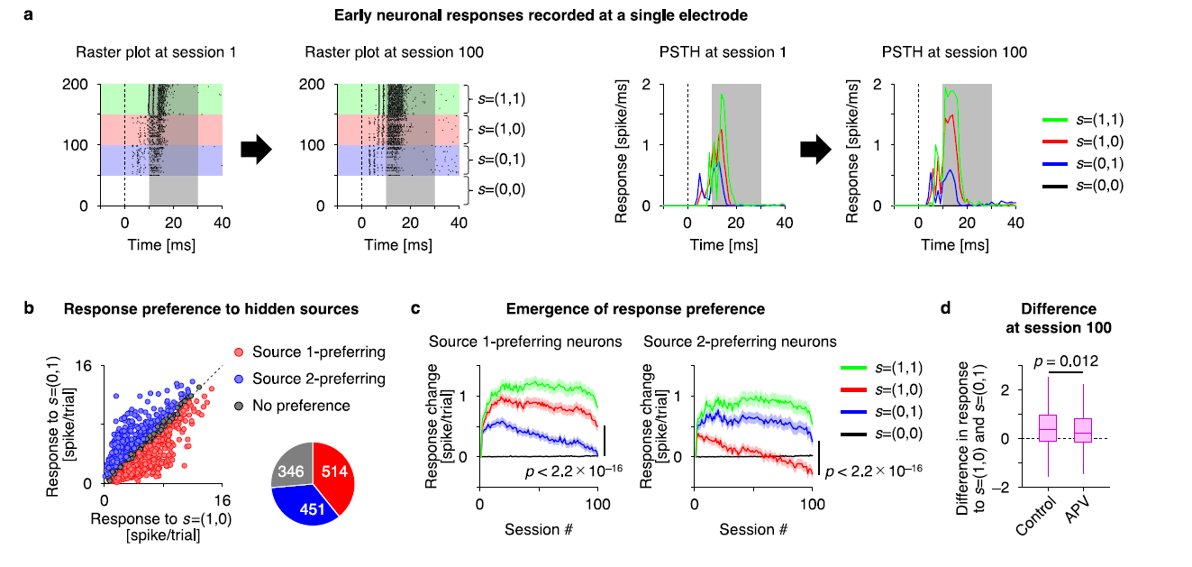
Notes:
Responses in shaded areas were used for analysis. Colors indicate hidden source condition
APV is an NMDA receptor antagonist, and mildly but significantly

Slide 18
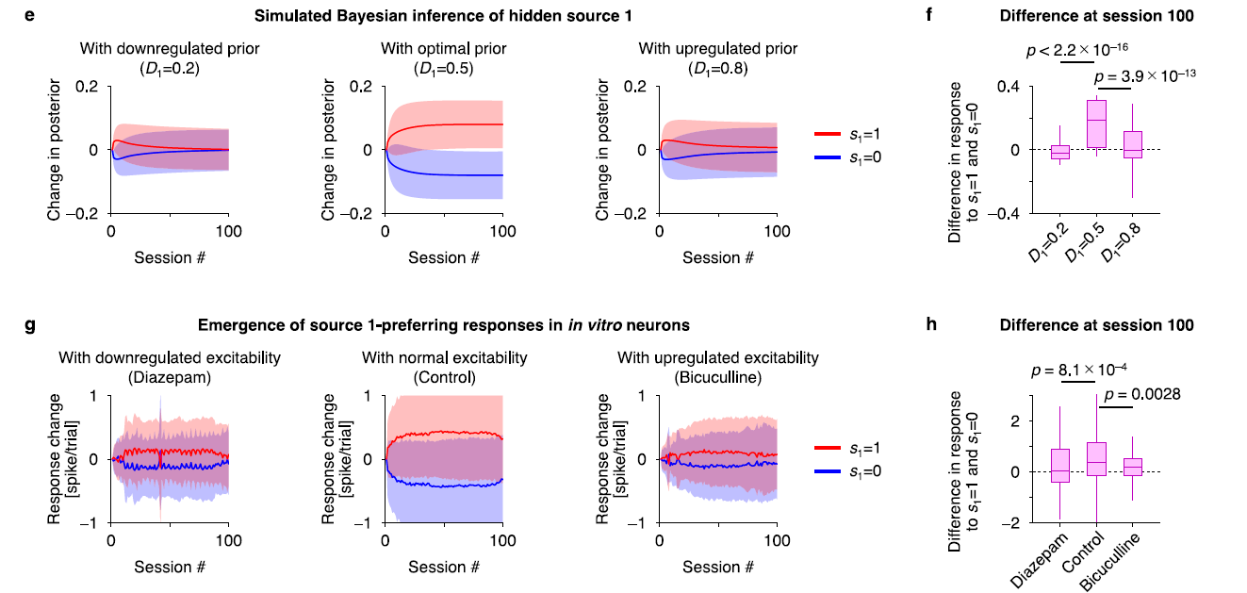
Notes:
Shaded area is standard dev
Ideal observer versus empiral data

Slide 19
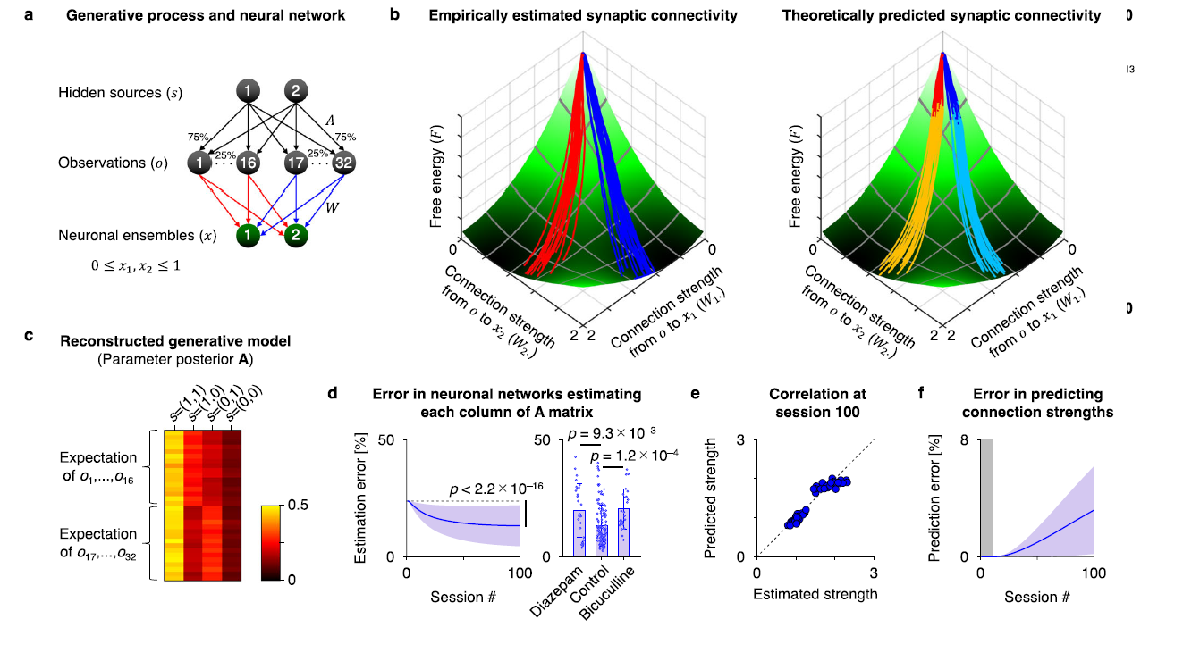
Notes:
Model of the in-silico representation of the neuronal network – red and blue lines indicate source-preference connectivities. These show again in b
Empirically estimated synaptic connectivity descending theoretical free energy gradient
Heatmap of posterior belief from generative model
The left stimuli group
(o1, . . . ,o16) in Fig. 1a (left) took the value of source 1 with a 75% probability
or the value of source 2 with a 25% probability. In contrast, the
right group (o17, . . . ,o32) took the value of source 1 or 2 with a 25% or
75% probability, respectively

Slide 20
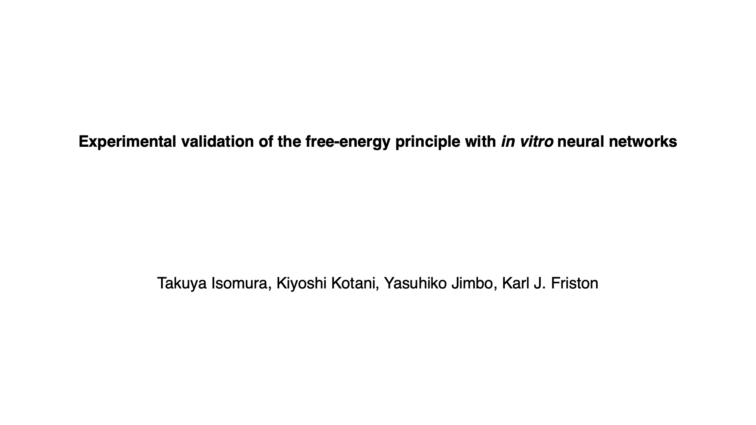

Slide 21
Summary
Cultured neurons can perform blind source separation
Neuronal self-organization trajectories can be predicted via variational Bayes/FEP

Slide 22
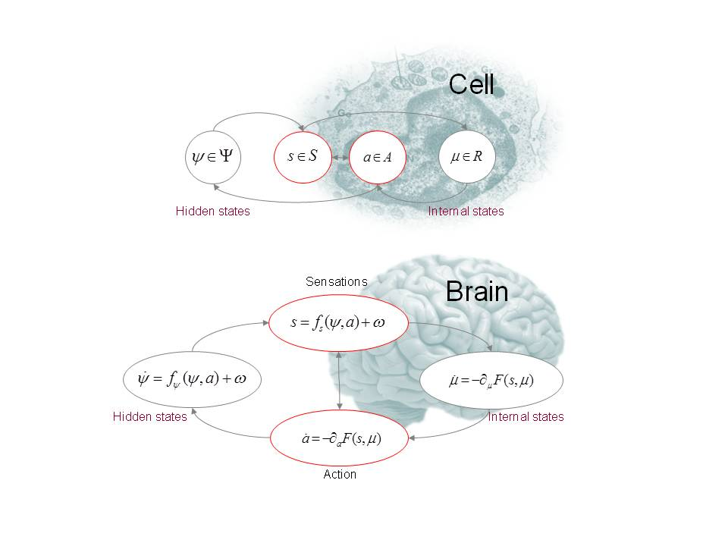
Discuss
Is a neuronal network a viable model of the brain?

Slide 23
Discuss
What is the value in a grand unified theory of the brain?
For neuroscience?
For psychology?
FEP counterexamples?
Carhart-Harris et al. (2023)

Slide 24
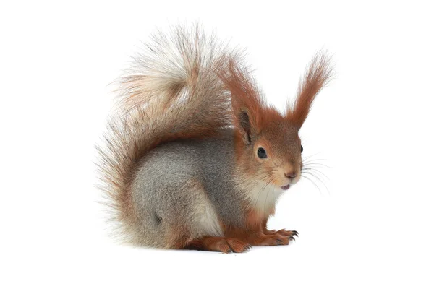
Discuss
“Beautiful. Undeniably true. But tells you absolutely nothing about…the actual phenotype.” –Karl Friston
Notes:
From Lex Fridman #99

Slide 25
Discuss
Where is the upper bound on what a brain predicts?
Is it limited by perception?
Compute?
Action?

